Slide 1

Real-Time Stock Market Analysis
Using Apache Spark and Apache Kafka
Submitted By: Ben Mishael, Lyr Ita , Neta Werner

Slide 2
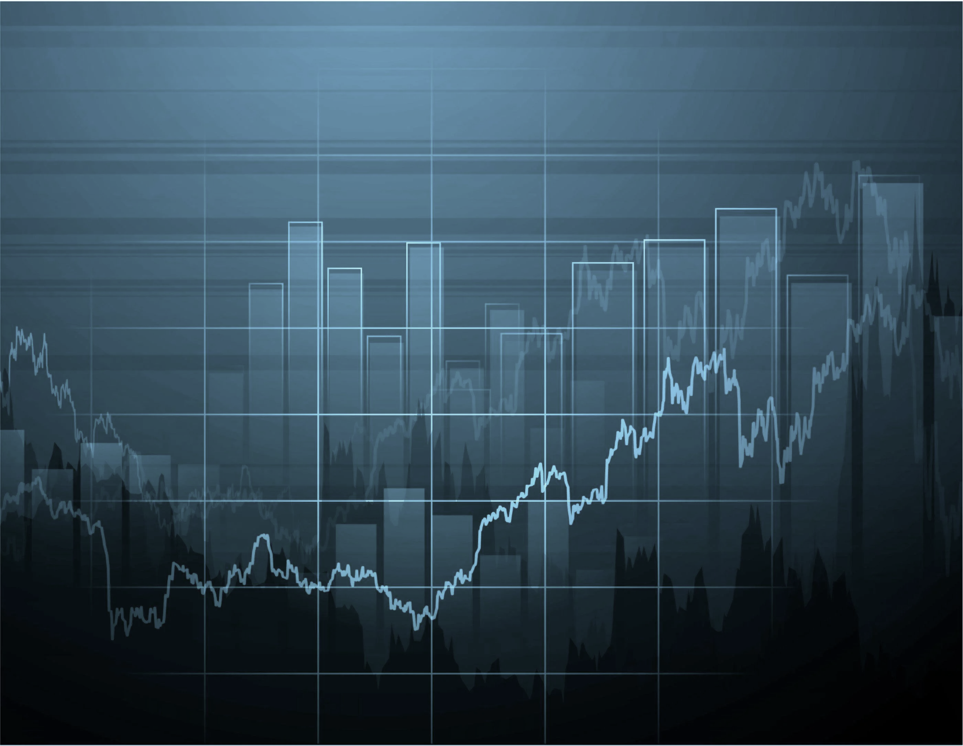
Introduction
Problem Definition:
News feeds, stock prices, social media sentiment, and economic indicators shape the stock market. Integrating and analyzing these diverse data streams in real-time is a significant challenge, but it can provide valuable insights into market trends and potential investment opportunities.
Our Objectives:
Demonstrate a system for real-time stock market prediction and analysis.
Provide insights into the stock market and allow users to monitor stock prices effectively
Utilizing Apache Spark for data analysis and Apache Kafka for data collection.

Slide 3
Why is such an app needed? (Or – why is it big data and why do we need Spark and Kafka to implement it?)
Real-time Insights, Real-time Action: Traditional analysis is slow. This app uses Apache Kafka for continuous data ingestion and PySpark for real-time analysis, allowing you to spot trends, react to events, and make informed decisions as they happen.
Deeper Risk Assessment and Opportunity Detection: Analyze streaming data to identify risks and opportunities. Monitor for price swings, gauge market sentiment, and adjust your strategy based on real-time insights. This includes detecting suspicious trading patterns that might indicate fraudulent activity.
Scalable Power for Big Data: The market generates massive amounts of data. PySpark's ability to handle large datasets efficiently makes it ideal for real-time analysis. It scales to accommodate growing data streams and utilizes distributed processing for faster, more efficient analysis.

Slide 4
Input Data definition
After searching for a free transaction dataset, we discovered that the only available sources were aggregated data. As a result, we opted to generate simulated data to represent each transaction individually.
The data structure:
Synthetic Trades Mocked Data
ticker | timestamp | price | volume | action
Synthetic ticker Mocked Data
ticker | Display name | country | Shs outstanding | Sector | Industry

Slide 5
Output Data definition Our project will produce output data that will be the base layer for a stock analyzer dashboard.
The includes data and graphs:
Calculate short interest – in the current time
Analyzing daily industry growth using a heatmap graph
Transaction type displaying (buy, short, sel)
Calculate the day’s volume for each stock.
Identify the stock with the highest average trading volume.
Heat map of the growing technologies market (Crypto, AI, Green Energy)
Display a heatmap showing the locations of growing companies by country.
Notes:
הגדרה – שורט אינטרסט – אחוז המניות שנמצאות ב״שורט״ הלוואה של מניות שלא באמת אצלך ואתה מוכר אותן – מכירה בחסר, מלווים מניות מהברוקר, מוכר אותן ולאחר מכן בפועל קונה ומרוויח על ההפרש.
ווליום – כמות המניות באותו יום שהחליפו ידיים ובעלות

Slide 6
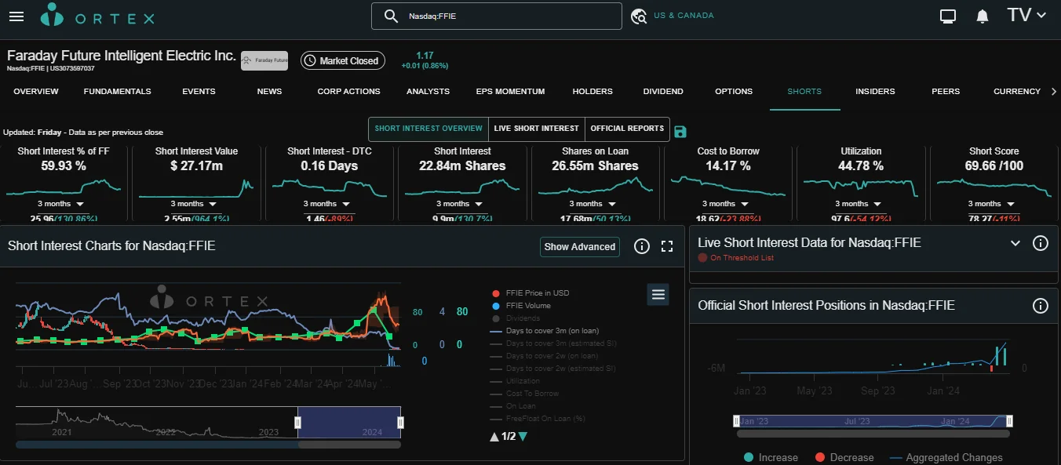

Slide 7
Lecturer review summarize
(based on the article "Real-time Stock Market Trend Analysis using Stream Processing Frameworks" )
Importance of Stream Analytics: The article emphasizes the growing importance of stream analytics in industries due to the increasing data from various sources. Real-time insights from these data streams aid businesses in making better decisions and enhancing efficiency, addressing latency, and ensuring data freshness for timely decision-making.
System Design and Architecture: Real-time stock market trend analysis involves integrating multiple data sources such as news feeds, social media, and stock prices, and processing the data using Apache Flink. The processed data is then displayed on a dynamic dashboard for informed decision-making based on the latest market trends.
Stream Processing Technologies: The survey covers the roles of Apache Spark Streaming, Apache Flink, and Kafka Streams in managing real-time data streams, highlighting their capabilities. These technologies combined provide robust, scalable, and low-latency solutions for real-time data processing.
Pyla, A., Mekala, R., & Ganjoo, A. (n.d.). *Real-time Stock Market Trend Analysis using Stream Processing Frameworks*. CS237 Project Report. Retrieved from https://ics.uci.edu/~cs237/project2023/CS237_Pyla.pdf.

Slide 8
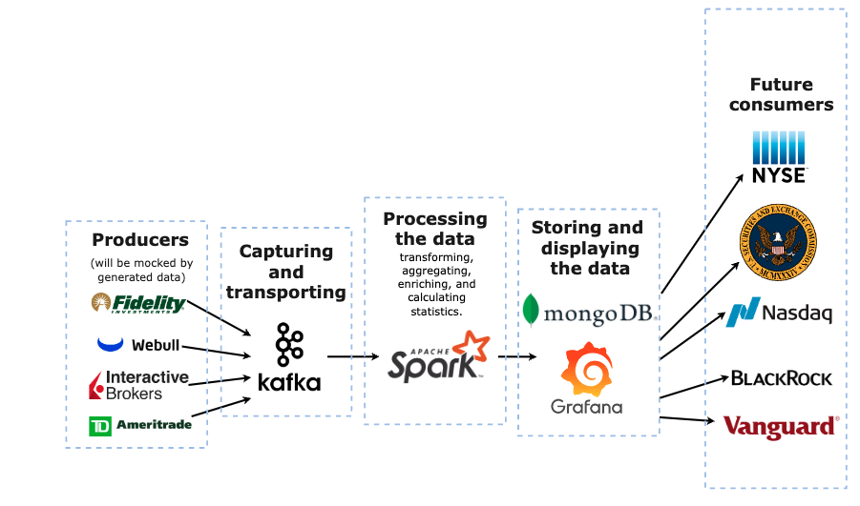
System Structure

